Slide 1
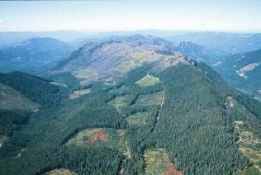
APPLICATION OF REMOTE SENSING IN ADDRESSING CLIMATE RELATED CHALLENGES IN TANZANIA
Mercy Mwanikah Ojoyi
University of KwaZulu-Natal, South Africa
IDRC Makerere University workshop Presentation, Uganda

Slide 2
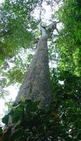
Presentation Outline
Introduction
Objectives
Methods
Findings
Discussions
Conclusions
Acknowledgements

Slide 3
Background
Natural ecosystems in sub-Saharan African face undesirable and rapid stresses
-climate change
-anthropogenic processes
Increasing CO₂ concentrations from fragmentation facilitate temperature rise, rainfall variability, alter ecosystem biophysical structure, moisture content, temperature, increasing vulnerability
Impacts on ecosystem functions and biodiversity
On-going debate on development of successful vulnerability frameworks needed for effective conservation and management interventions particularly in complex and dynamic environments with inadequate geographic data
Source (Walker and Salt, 2006).

Slide 4
Research gaps
Few detailed studies exist human interactions with ecosystem impacts in Africa
In East Africa, the change Impacts remains a complex and not well explored subject
Limited research covers impacts of cover change on ecosystems & their functioning
This is fundamental for planning towards protection of vulnerable ecosystems and future scenario protection measures
Source:(IUCN, 2010; Maitima et al., 2009)

Slide 5
Goal
The main goal of the project is to report on emerging factors driving natural ecosystem change and impacts on biodiversity (climatic, biophysical and biological) and long term implications.

Slide 6
Specific objectives
Quantify change at temporal and spatial scales
Impacts on dominant vegetation
Conservation Implications and policy recommendations

Slide 7
EASTERN ARC MOUNTAINS IN EAST AFRICA
The Eastern Arc Mountains- a biodiversity hotspot in Africa
Challenges:
Deforestation for agriculture
Human pressure e.g. tree logging in Kitulangalo
Ecosystem change and functioning
Varying Rain fall patterns
c) Lower river flows
d) Drying of major rivers opening up intact forests

Slide 8
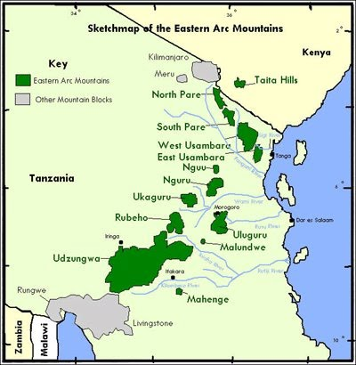
Forest blocks: Nguru & Uluguru

Slide 9
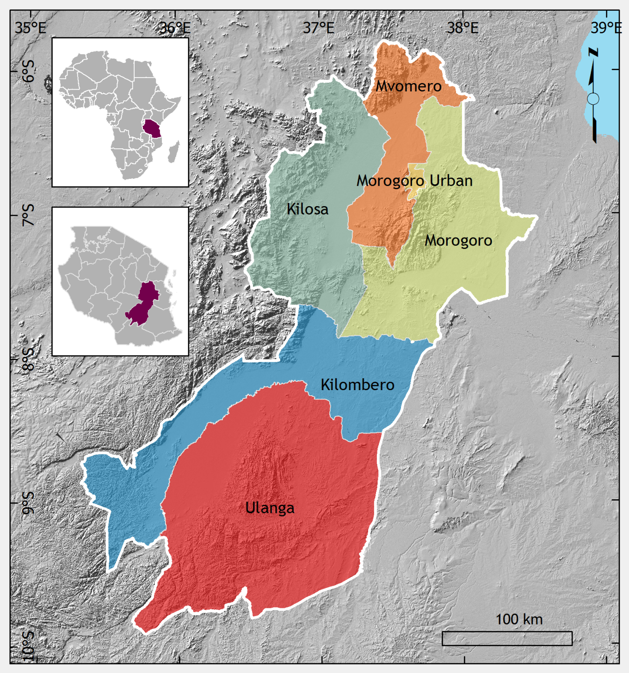
Villages location in diverse districts

Slide 10
Assessing vulnerability
$$Vulnerability=f\left(Household characteristics+human activities+perceptions on forest cover changes\right) Equation$$

Slide 11
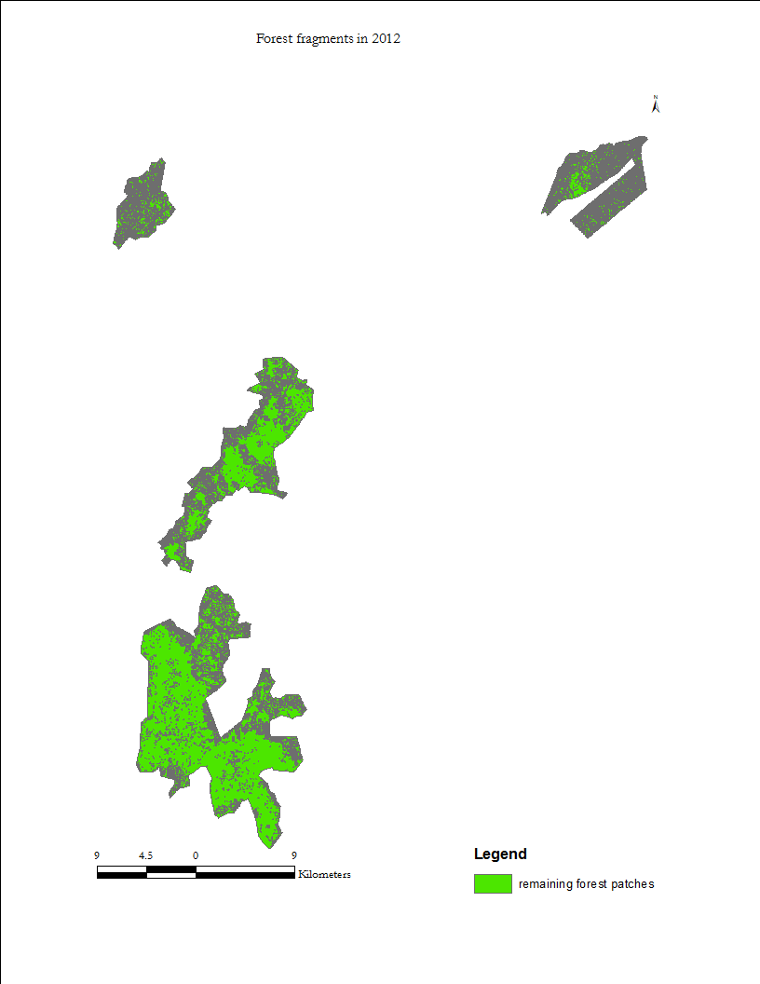
Natural ecosystem vulnerability
Grey areas- deforested

Slide 12
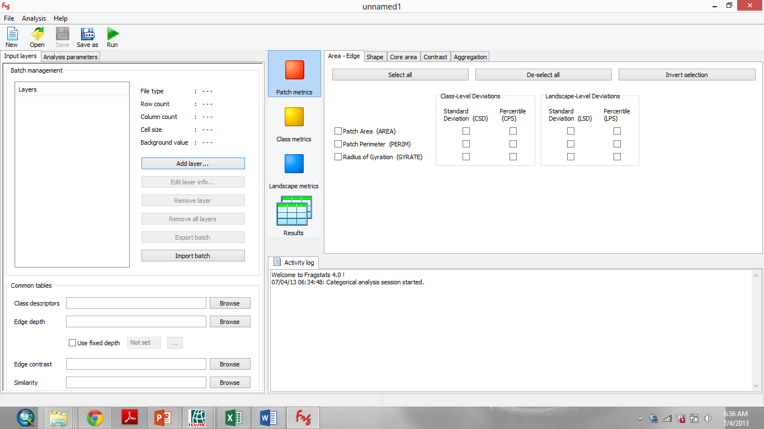
GUI Fragstats
Fragstats Metrics
Patch
Class
Landscape

Slide 14
LANDSCAPE METRICS RESULTS
Factor | 1975 | 1995 | 2012
Number of patches (No. per 100 hectares) | 37799 | 38473 | 32619
Patch density | 10.3388 | 10.5023 | 8.9043

Slide 15
ANOVA TESTS FOR SIGNIFICANCES IN MEANS IN PATCHES IN R-Software
-Testing for significant differences in patches from 1975-2012
VARIABLE | TESTS
Dense forest | ANOVA Df Sum Sq Mean Sq F value Pr(>F) TYPE 2 6.241e+05 312060 2.477 0.084 . Residuals 9159 1.154e+09 125974 --- Signif. codes: 0 ‘***’ 0.001 ‘**’ 0.01 ‘*’ 0.05 ‘.’ 0.1 ‘ ’ 1
Less dense forest | TukeyHSD (anova.test) Df Sum Sq Mean Sq F value Pr(>F) TYPE 2 429 214.63 148.3 <2e-16 ***Residuals 16581 24002 1.45 ---Signif. codes: 0 ‘***’ 0.001 ‘**’ 0.01 ‘*’ 0.05 ‘.’ 0.1 ‘ ’ 1

Slide 16
ECOSYSTEM VULNERABILITY
Poor income (54.62%)
Lack of capacity building (18.51%)
Emerging factors include:
-Livelihood diversification
-Strengthen institutional frameworks
-Restoration efforts

Slide 17
DISCUSSION
Based on the results, habitat fragmentation has an negative effects on vegetation
Emerging factors include:
-Livelihood diversification
-Strengthen institutional frameworks
-Restoration efforts

Slide 18
CONCLUSIONS
Satellite data enable quantification of change and impacts in biodiversity hotspots in the Eastern Arc Mountains in East Africa
Quantified fragmentation patterns for more than 37 years in the two fragile ecosystems which are important biodiversity hotspots in the country
Changing patterns have effects on vegetation
Knowledge generated on the best mechanisms to apply as a way of safeguarding the vulnerable ecosystem

Slide 19
RECOMMENDATIONS
Engage appropriate conservation measures to control increasing drivers to human induced threats
Engage local stakeholders and leaders in long term sustainable conservation plans of the vulnerable “biodiversity hotspots”
Prioritize effective institutional frameworks

Slide 20
ACKNOWLEDGEMENTS
IDRC
University of Nairobi
Makerere University
University of Kwazulu-Natal, Environmental Sciences, Pietermaritzburg, South Africa

